Slide 1


Communities and Crimes
ECS 171: Group Project
Group 12: Vedant Apte, Annmarie Adams, Loren Aguilar, Matthew Boentoro, Dongyu Chen, Anqi Liu, Tien Ly, Boyang Meng, Matthew Morales, Yifan Shen, Hengze Ye

Slide 2



Problem Description
Why do we care?
Violent crime is ubiquitous in modern American society.
Violent crime rates vary across different communities in the United States
High crime rates have severe economic and social impacts on communities
Motivation:
To identify why violent crime rates vary
To provide solutions for reducing violent crime rates
To assist policymakers in enacting effective legislation
Goal:
Identify the relationships between communal attributes and violent crime rates in communities
Build a ML model to predict the violent crime rate per 100K given certain communal attributes

Slide 3

Related Work
Similar work done on the topic
FBI. Crime in the United States by Community Type. 2011.
Noah Atchison. Community Organizations Have Important Role in Lowering Crime Rates. Brennan Center, April 20, 2018.
Kerry L. McIver, Marsha Dowda, Cheryl L. Addy, Russell R. Pate, William H. Brown, Karin A. Pfeiffer. Social and environmental factors associated with preschoolers’ non-sedentary physical activity. Society for Research in Child Development, Inc., 05 February 2009.
Brandon C. Welsh, David P. Farrington. Preventing crime: What works for children, offenders, victims and places. Springer, 2007.
Dan Jasper. How community involvement can reduce crime. Street Civics, 2021.

Slide 4
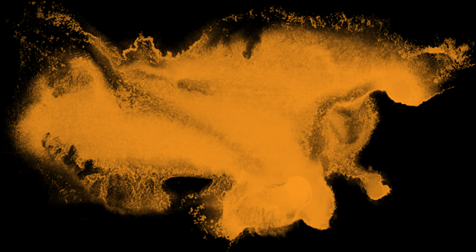

Data Set Description
How we solved the problem
Family:
PctKids2Par: percentage of kids in family housing with two parents
TotalPctDiv: percentage of population that is divorced
PctIlleg: percentage of kids born to individuals that never married
Wealth:
PctPopUnderPov: percentage of population that is under the poverty level
pctWPubAsst: percentage of population with public assistance income
pctWInvInc: percentage of population with investment income
Race:
racepctblack: percentage of population that is African American
racePctWhite: percentage of population that is white
Goal
ViolentCrimesPerPop: total number of violent crimes per 100K population
UCI's Communities and Crime Data Set
128 attributes: 122 predictive, 5 non-predictive, 1 goal
1994 instances

Slide 5
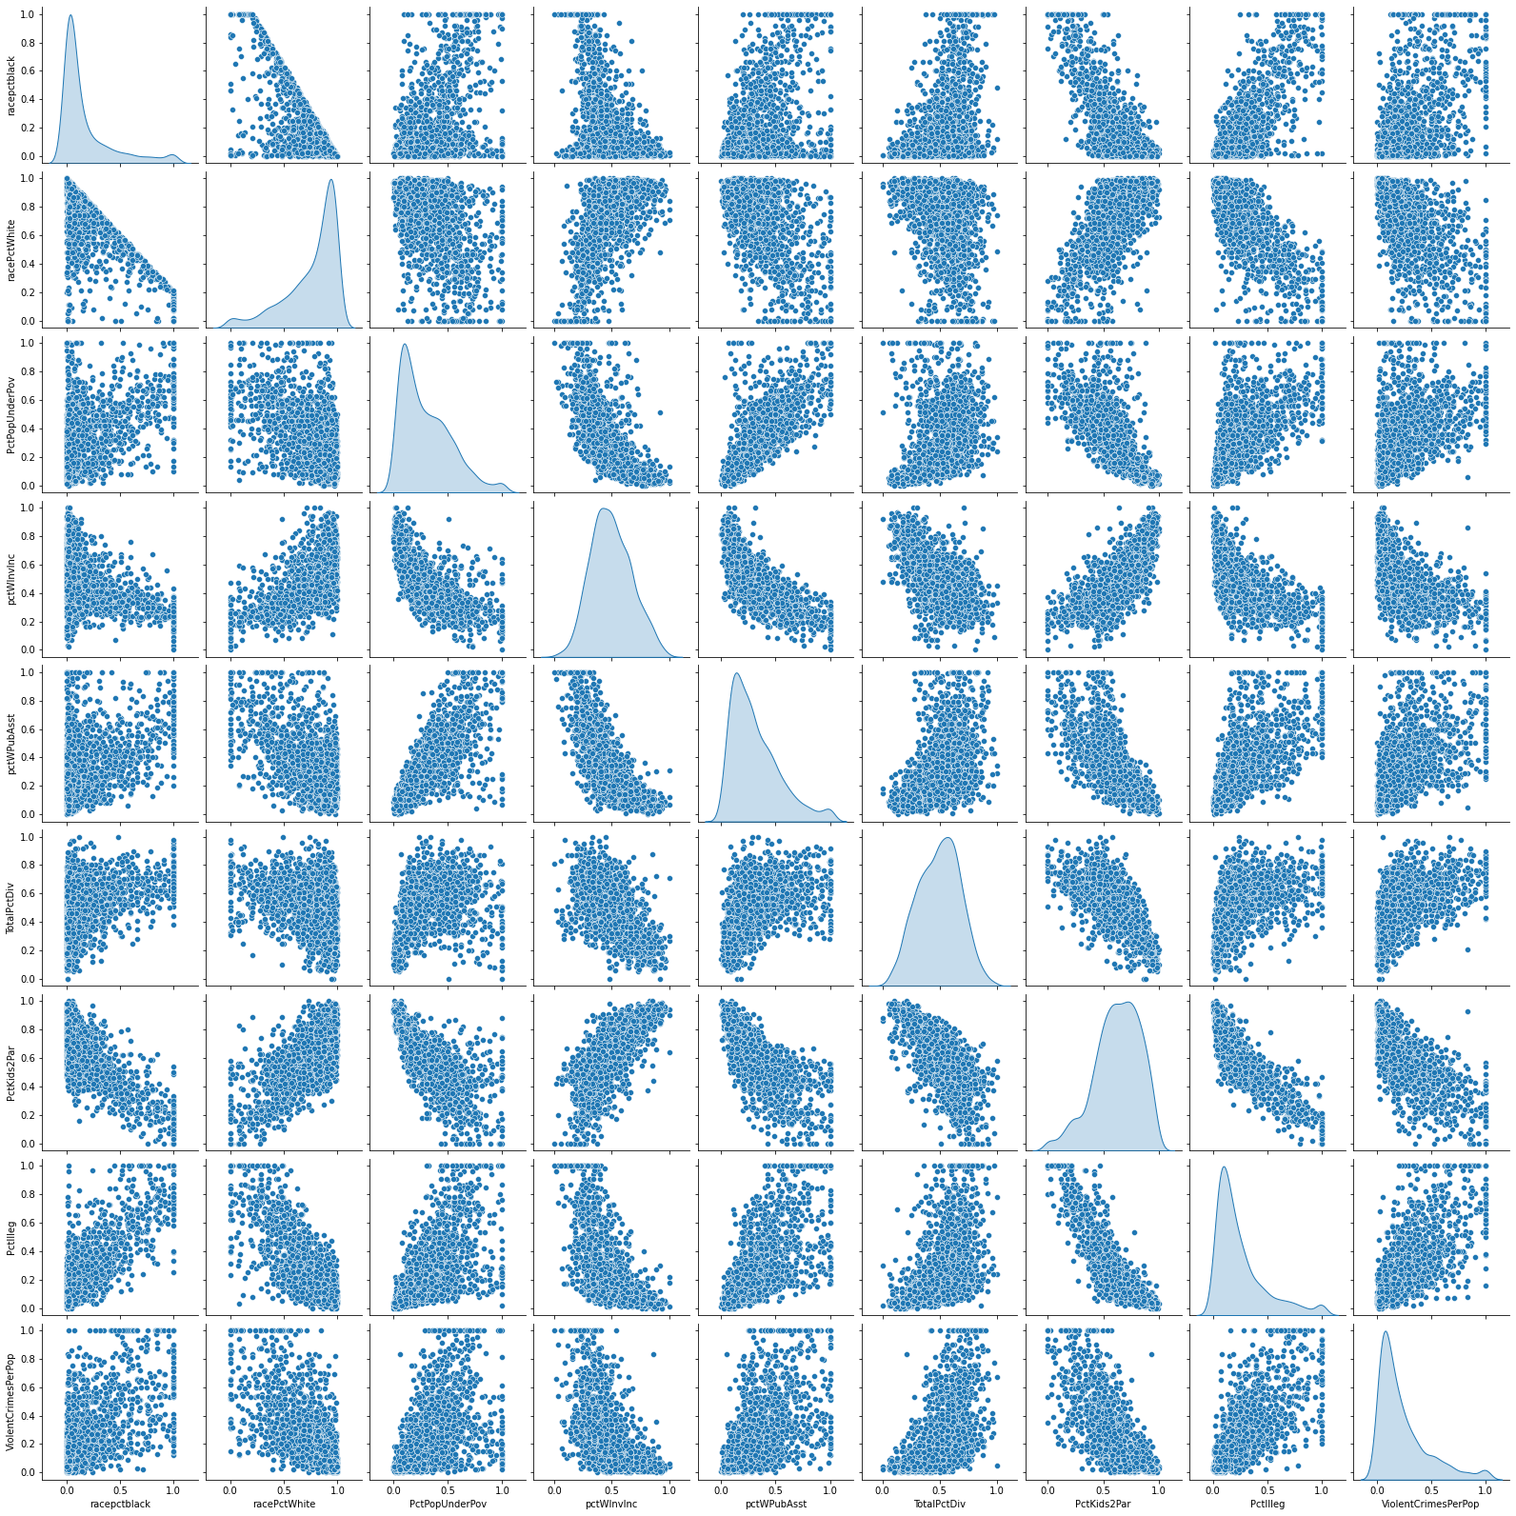
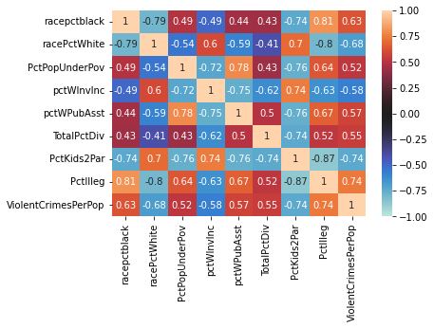
Proposed Methodology
How we solved the problem

Slide 6


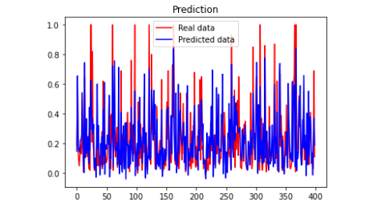
Evaluation of Methods
Linear Regression Model
Comparison Type vs. Violent Crimes Per 100K | Average MSE (10-fold cross validation)
Family attributes | 0.0223
Wealth attributes | 0.0337
Race attributes | 0.0278
All attributes | 0.0210
Notes:
Linear regression model with k-fold cross validation with n-splits (10), MSE average to quantify accuracy

Slide 7
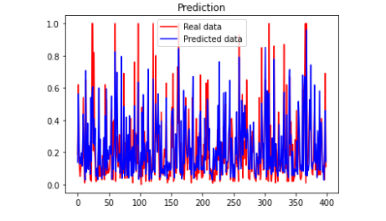

Evaluation of Methods (cont.)
Neural Network Model
3 hidden layers (40, 10, 4)
ReLU activation
Learning rate: 0.01
Comparison Type vs. Violent Crimes Per 100K | Average MSE (10-fold cross validation)
Family attributes | 0.0216
Wealth attributes | 0.0320
Race attributes | 0.0275
All attributes | 0.0179

Slide 8


Conclusion
Results and call to action
Both linear regression (MSE = 0.0210) and ANN (MSE = 0.0179) performed well.
Because the data set was not perfectly linear, the neural network performed marginally better.
Current values only predict a normalized number for violent crimes per 100K.
Future plan: use the unnormalized dataset and normalize it ourselves, then apply our model and transform the prediction back to a numeric number
Because there are considerable links between community attributes and crime rates, improving these attributes can aid in stabilizing our social security.
Reduce racial profiling
Increase general social wealth / fight poverty
Encourage healthy and complete families / improve family relationships
Notes:
Community organizations can help reduce crime rate by creating support structures for individuals and to promote these positive value systems to the public eye.
The federal legislation system can help by passing bills that help reform the community and to reduce any existing unfair bias in the judicial system. They may also provide funding for the state to help communities reduce the overall crime rate.
Researchers can improve continual research on crime rate by improving their info gathering such as avoiding outdated surveying and interview methods to the data.

Slide 9

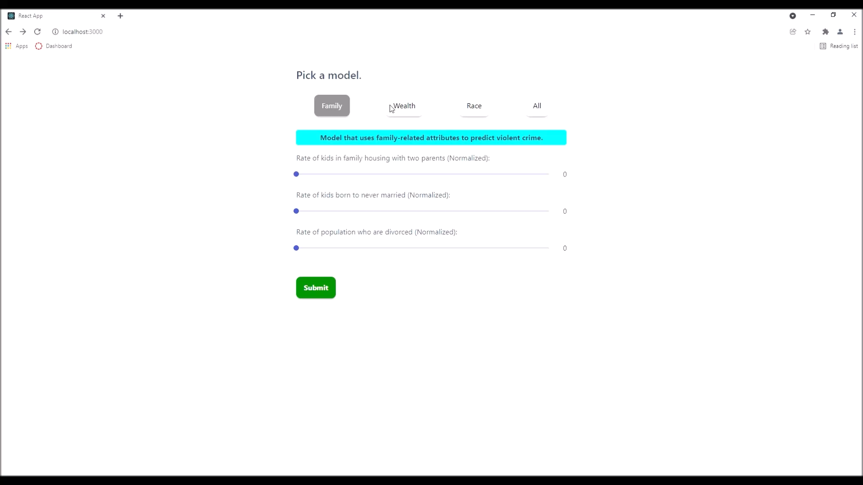
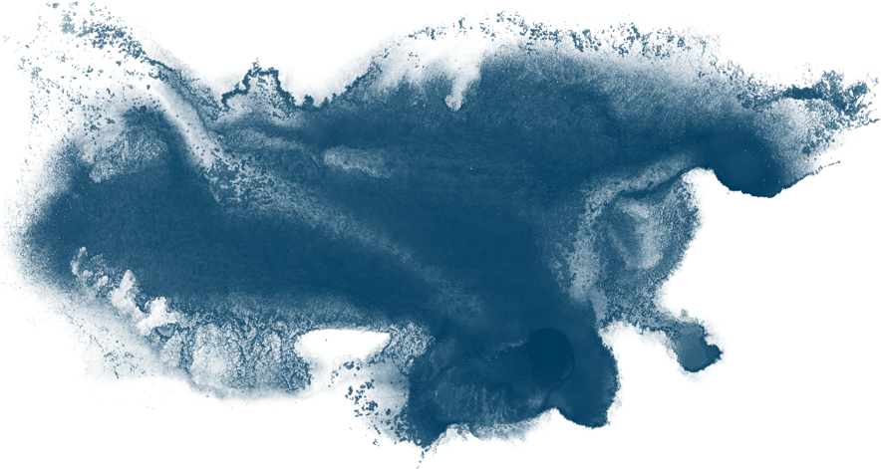

Questions?

